Slide 1
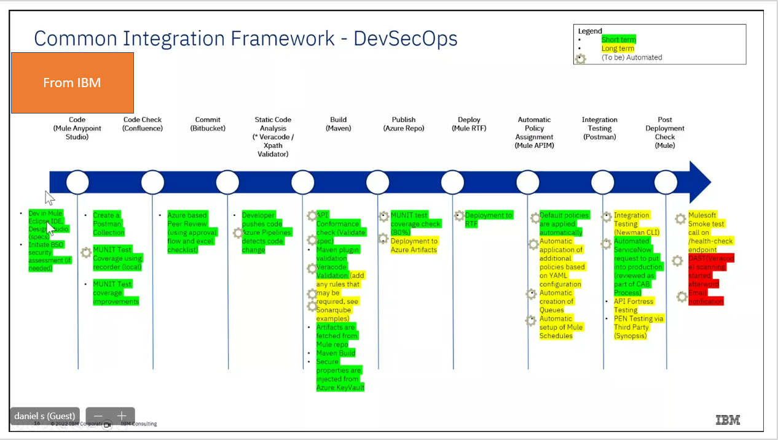

Slide 2
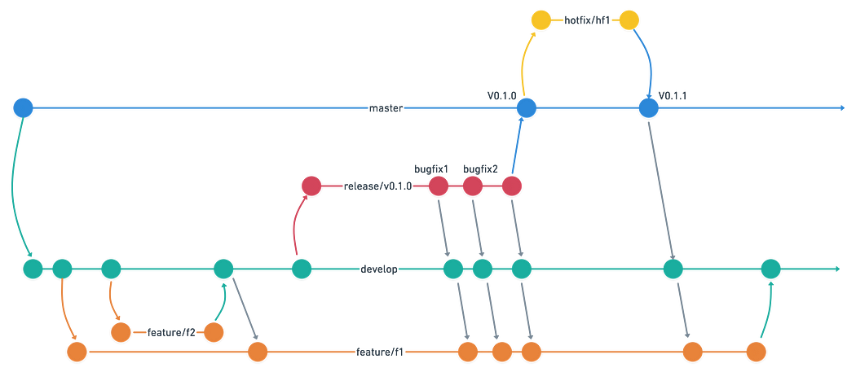
1.) Master
2.) Develop
3.) Feature / Bug Fixes / Issues
4.) Release
5.) Hotfix

Slide 3
CICD - Branching Strategy
Main Branch
Tag Ph 1
Tag Ph 2
Tag Ph n
Main Branch
This will be the production replica branch and code here will be deployed to PROD environment. Code from Release branch will be merged into Main branch.
Feature Branch,
This branch would be used to work on defect/features.
Dev Branch
This branch would be the branch where all the feature branches will be merged once the code is reviewed, fixed and all the unit tests are performed. This branch will be deployed to the Dev environment.
Release Branch
This will used for deployment into higher than Dev environment i.e. INT, UAT, PROD. Code will be moved from Development branch to Release branch.
Release-x Branch
Temporary branches to manage build while ‘Release branch’ to be used for previous phase release for business in Stage
NOTE: Any bug fix at Release branch, the fixes need to merged to “Dev” as well as all active “Release-x” branches
Release to prod
Hotfix Branch
Release Branch
(ph1 code)
(ph1 + ph2 code)
(ph1 +..+ ph n code)
Release-N (ph1 +…+ ph n)
Release-2 (ph1 + ph2)
Dev Branch
Feature branch
Feature branch
Feature branch
Dev branch must be updated as & when Main is updated with any new release

Slide 4






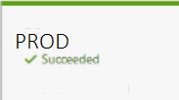
CICD – Flow Sequence
2
Commit changes
Feature Branch
Developer pulls code from Dev branch to new feature branch to work on his changes
Developer commits code to a feature branch
Developer raises Pull Request(PR) to merge feature branch with the Develop branch
once PR is approved by peer reviewer, feature branch is merged with Dev branch
Upon code merged to Dev branch, automatic Azure “CICD Dev pipeline” is triggered
Automatic Azure CICD pipeline does build & deploy API to CloudHub DEV environment
Developer Tests his changes in DEV environment
To promote to INT environment for SIT, code is merged to Release Branch, as per MuleSoft Branching strategy
Upon code merged to Release branch, automatic Azure “CICD Release pipeline” is triggered
Code gets deployed to INT environment, SIT occurs
Once SIT is approved, then UAT Stage of “CICD Release Pipeline” is approved by Lead, code promoted to UAT CloudHub environment
Once UAT tests approved, , then PROD Stage of “CICD Release Pipeline” is approved by Lead, code promoted to PROD CloudHub environment
Code merged from release to Man Branch, so that it reflects the code in PROD
1
Pull
3
Test changes
Pull/Merge Request
7
Dev Branch
4
Merge on PR changes
5
6
DEV
CICD Dev Pipeline
8
INT
10
Release Branch
9
UAT
CICD Release Pipeline
11
13
PROD
12
Main Branch

Slide 5
Microservices Decomposition
Microservices Communications (Sync / Async Message-Based Communication, API Gateways)
Microservices Data Management (Databases / Query / Commands)
Microservices Transaction Management
Microservices Distributed Caching
Microservices Deployments with Containers and Orchestrators
Microservices Resilience

Slide 6
The Database-per-Service Pattern
API Gateway Pattern, Gateway Routing/Aggregation/Offloading Pattern
Backends for Frontends pattern BFF
Service Aggregator Pattern, Service Registry/Discovery Pattern
Fan-out Publish/Subscribe Messaging Pattern
Topic-Queue Chaining & Load Balancing Pattern
The Shared Database Anti-Pattern and Polyglot Persistence
Database Sharding Pattern, CAP Theorem
Materialized View Pattern
CQRS and Event Sourcing Patterns
SAGA Pattern — Choreography-based/Orchestration-based SAGA
Compensating Transaction Pattern
Transactional Outbox Pattern
Dual Write Problem
CDC — Change Data Capture with Outbox Pattern
Event Hubs and Real-time Event Streaming in Event-Driven Microservices Architecture
Cache-Aside Pattern for Microservices Distributed Caching
Sidecar Pattern
Service Mesh Pattern
DevOps and CI/CD Pipelines for Microservices Deployments
Deployment Strategies for Microservices: Blue-green, Rolling and Canary deployments
Infrastructure as Code (IaC) and usage in Microservices Deployments
Microservices Resilience, Observability and Monitoring Patterns
Retry and Circuit Breaker Patterns
Bulkhead / Timeout / Cache / Fallback Patterns

